Slide 1
Detecting and Classifying Short-finned Pilot Whale Acoustics with Deep Learning
Virginia Pan
Nowacek Acoustics and Engineering Lab
Pratt school of engineering and duke marine lab
Notes:
Hi, my name is Virginia Pan, and I have been working on detecting and classifying short-finned pilot whale acoustics using deep learning.

Slide 2
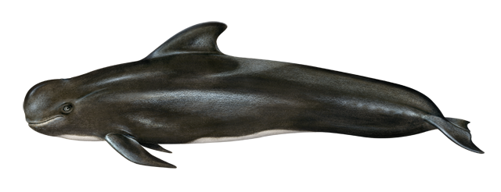
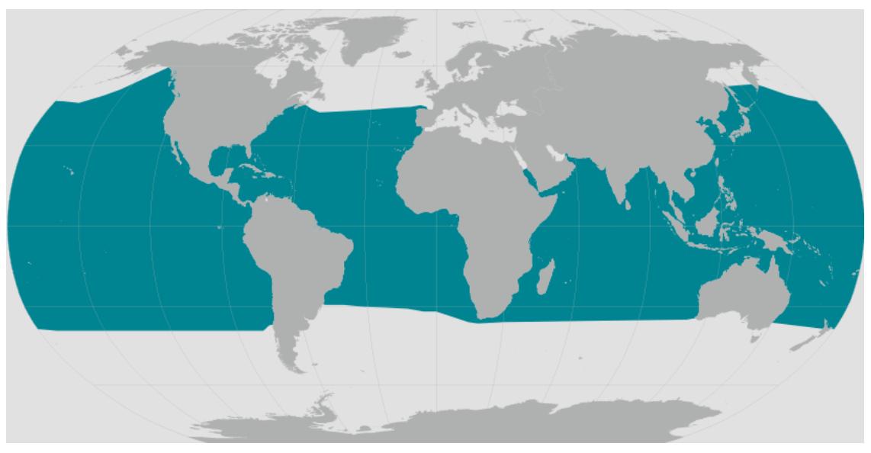
Short-finned Pilot Whales Globicephala macrorhynchus
[1]
Notes:
Short-finned pilot whales are deep diving cetaceans that use sound for navigation, hunting, and communication. They are globally distributed around the world’s tropical and temperate oceans. They use echolocation to hunt for fish and squid at depths exceeding 1,000 feet.
________________________________________________________________________________________________________________
Globicephala macrorhynchus
Distribution: global tropical and temperate oceans
Live long, slow to reproduce
Highly social: live in stable family groups (15-30 individuals)
Diet: Squid and fish
Hunt in moderately deep water of 1,000 feet or more
Use sound for navigation, hunting and communication
Often involved in mass standings- unclear why
“Cheetahs of the deep sea” due to deep, high speed dives to chase and capture large squid
https://www.fisheries.noaa.gov/species/short-finned-pilot-whale

Slide 3
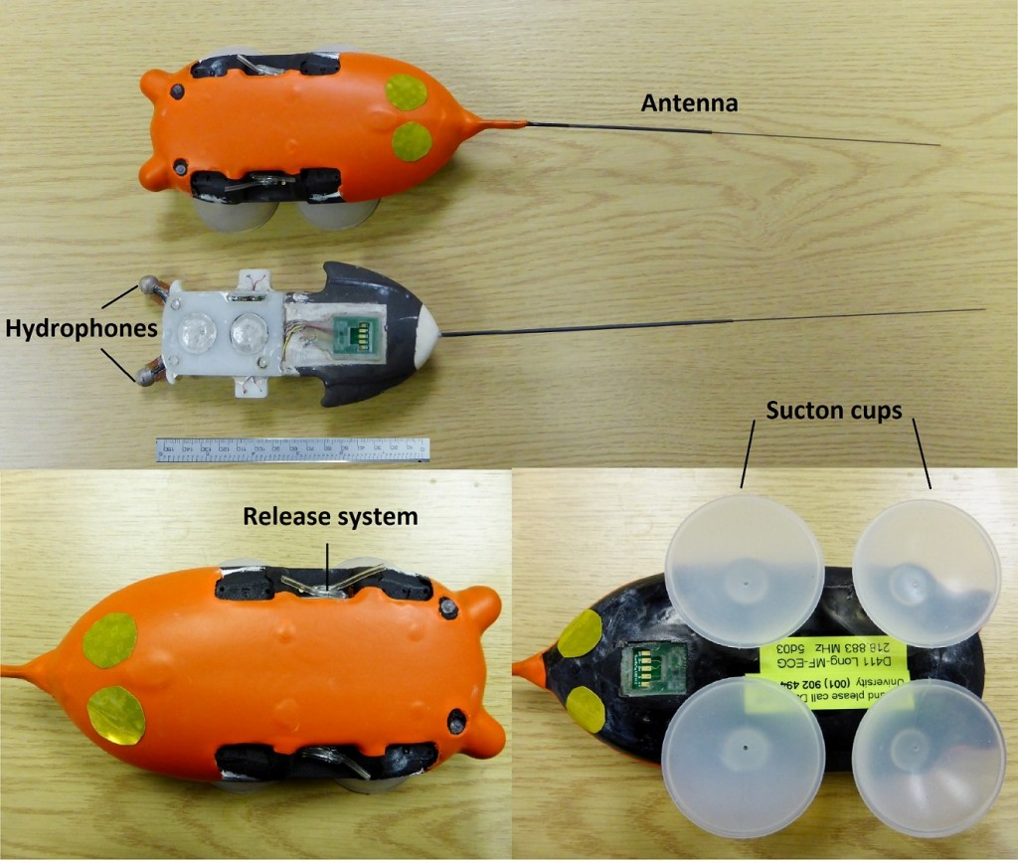
Digital Acoustic Recording Tag (DTAG)
[2]
Notes:
Scientists use Digital Acoustic Recording Tags (DTAG) to collect depth, movement, and audio data that provide insight on short-finned pilot whale’s behavior. The tag attaches to the animal via suction cups and is released using a burn wire. Researchers from the Duke Marine Lab travel offshore Cape Hatteras, NC and tag short finned pilot whales each summer. In this study, I looked at 25 tagged individuals from 2008, 2010, and 2011.
________________________________________________________________________________________________________________
Records audio, pitch, roll, heading, and depth
Can study social interactions, foraging, diving and ecology
Nowacek Lab annually tags short-finned pilot whales off Cape Hatteras
Sound and movement recording tags designed for use on marine animals
Resistant to pressure in deep waters
Can study social interactions, foraging, diving and ecology
Nowacek Lab tags short finned pilot whales off the cost of Cape Hatteras every summer
Using data from 2010, 2011, 2008

Slide 4
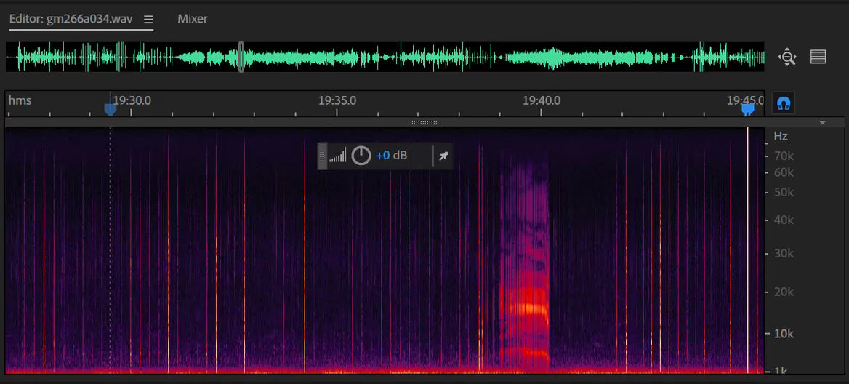
Background
Preexisting method: Manual classification
Problem: Manual review of DTAG audio is time consuming and requires a trained ear!
Goal: create a workflow for automatic detection and classification of DTAG audio
Notes:
Typically, someone listens to recorded DTAG audio and annotates the start time, duration and type of acoustic event they hear.
However, manual review of DTAG audio recordings can be time consuming and requires a trained ear.
Thus, the goal of this project is to automate the processing of DTAG audio by developing a detection and classification scheme.
________________________________________________________________________________________________________________
Background:
Many types of sounds in tag recordings, such as whale buzzes, minibuzzes, calls, and clicks
Q: Proposes of each kind of acoustic event?
Started off model by focusing on differentiating between buzzes and minibuzzes
Didn’t include calls because they are more complicated and varied
Didn’t include clicks because they happen over longer time periods and are intermittent between buzzes and minibuzzes
Larger goal: to make a tool that can be used to find and classify events in DTAG recordings rather than manually having to listen and record timestamps of events by hand (high labor and time costs)
Notes about data:
Started with 2010 data
11 individuals tagged
Time ranging from 24 minutes to 17 hours and 27 minutes
56 hours 57 minutes of audio (about 57 hours)
(5 in 2008, 11 in 2010 and 9 in 2011).

Slide 5
Literature Review
A) Classical techniques for Marine Mammal PAM
Whistles: contour analysis [3]
Buzzes: fundamental frequency and harmonics [4]
Feature extraction, Energy based algorithms, Hidden Markov Models, Gaussian Mixture Models, Information Entropy, Hilbert Huang Transform and more
B) Learning based approaches for other animal sounds
Convolution-LSTM hybrid network for elephant PAM [6]
Faster-RCNN for detection and k-means for classification for lab mice squeaks [7]
End-to-end feed forward CNN for marmoset monkey audio [8]
Although some results from learning based approaches with simultaneous detection and classification were successful, I chose to separate classification and detection for modularity and ability to experimentally validate each step separately.
Notes:
In my literature review, I looked at two main groups of articles. The first group was classical techniques for detection and classification of marine mammal passive acoustic monitoring (PAM) audio, including more detailed contour, fundamental frequency, and harmonic analysis. The second group of articles used deep learning based approaches for different animal sounds, including elephants, lab mice, and monkeys. Although results from learning based approaches were successful, I chose to separate classification and detection for modularity and ability to experimentally validate each step separately.

Slide 6
Audio Pre-processing
Notes:
Before experimenting with classification and detection, I had to pre-process the audio.

Slide 7
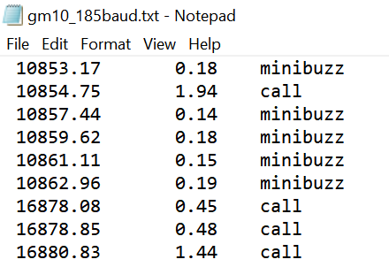
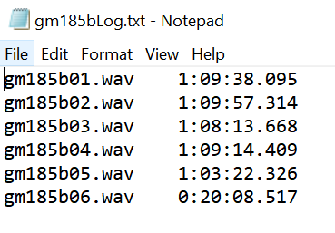
Segmenting Audio Clips
Audit
File
Raw Recording
Clipped Recording
Start Duration Type
Log
File
Buzz
(1556)
Minibuzz
(423)
Filename Length
Notes:
I used human generated audit and log files to extract buzz and minibuzz audio clips from DTAG recordings. I choose to focus on buzz and minibuzz sounds because they are contained, consistent, and are of biological interest, because they are used during the final stages of feeding.
________________________________________________________________________________________________________________
Short-finned pilot whales make many different types of noises, including buzzes, minibuzzes, calls and clicks. Clicks are produced during echolocation to navigate and search for prey. Buzzes and minibuzzes are used towards the end of prey capture to hone in on their target. Calls are used in social interactions and are very variable.
Focused on buzz and minibuzz vocalizations
Data from 2008, 2010, and 2011 (25 individuals total)
Log file: chronological list of audio segments for an individual
Audit file: Manually reviewed audio for whale sounds
Extracted audio clips
Used Pydub library to split audio
Use audit file to extract “buzz” and “minibuzz events” from whole recordings
1st col: start time (sec)
2nd col: duration (sec)
3rd col: type of event
Note: Recordings are separated into roughly hour long chunks and audit files are continuous throughout all recordings
For shorter recordings: was able to concatenate all sections are parse through to get each event
For longer recordings: needed to loop through sections (addition of log file) and correspond events in audit file to correct time in correct recording because total concatenated recording could not all be loaded into python at once (2:17 clip could be loaded in, 5:48 clip could not be loaded in)
Yielded clipped recordings [insert example of buzz and minibuzz]

Slide 8
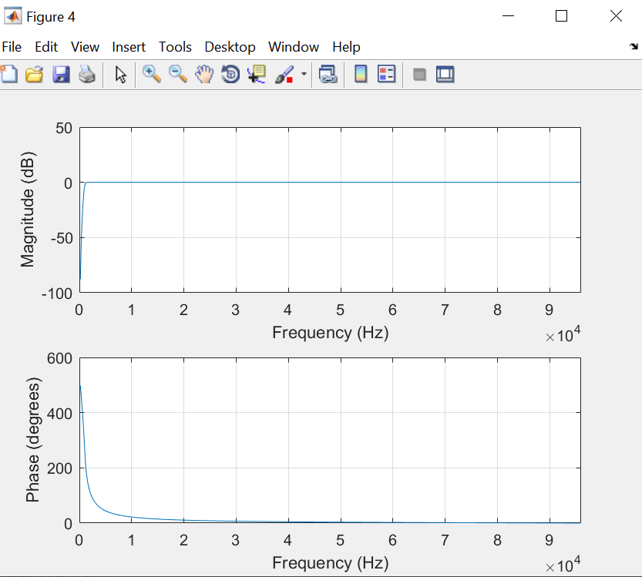

High Pass Filter
Butterworth Filter
Cutoff frequency: 1 kHz
Cut out low frequency noise
Unfiltered
Filtered
STFT of filtered audio clips served as input to classification network
Magnitude and phase response of high-pass Butterworth filter, 1kHz cutoff frequency
Notes:
I then used a High Pass Butterworth filter with cutoff frequency of 1kHz to eliminate low frequency noise. Plotted are the magnitude and frequency responses of the filter. I took the short time Fourier Transform (STFT) of each filtered audio clip as the input for my classification network.

Slide 9
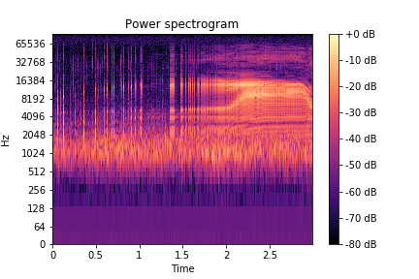
Buzz STFT
Buzz
Notes:
Here’s an example spectrogram and sound of a Buzz.

Slide 10
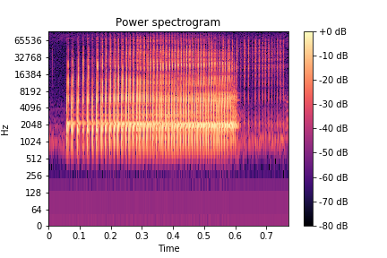
Minibuzz STFT
Minibuzz
Notes:
Here’s an example spectrogram and sound of a Minibuzz.

Slide 11


Mixing and sorting of 2010 training, testing and evaluation data
1973 events total
Buzzes
1,550 events
~79%
Randomly
Choose
423 buzzes
Minibuzzes
423 events
~21%
846 events total
Training
546 events
~65%
Testing
170 events
~20%
Validation
130 events
~15%
Notes:
In the 2010 data, there were many more buzzes then minibuzzes. I took an equal amount of each and randomly divided them into training, testing, and validation sets of 65%, 20% and 15% respectively.

Slide 12
Classification with Deep Learning
Notes:
Now I’ll talk about my deep learning model to classify between buzzes and minibuzzes.

Slide 13
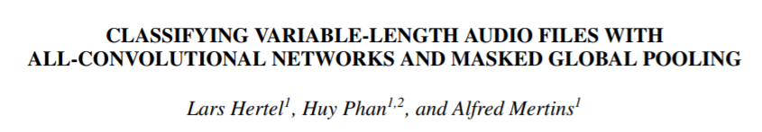
Neural Network Model
Input: STFTs and labels (correct classification)
Output: buzz or minibuzz
Challenges
Different length audio → Global pooling
Lots of training data → Load in batches
Notes:
The input to the network were STFTs with the correct labels. The output was classification of the clip as a buzz or minibuzz. One of the primary challenges of working with this dataset was having different length audio segments. This was resolved by using a global pooling layer right before the fully connected layer as outlined in this article by Hertel et al, which was the basis for the neural network I used.

Slide 14

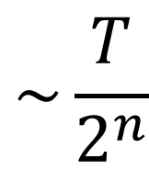
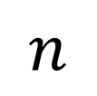
1025
ReLU
3, with stride 2
T
T
*
*
$$\sim \frac{T}{2^{n}}$$
T
…256
256
256
1025
256
…256
1025: value from STFT
N=2048
Window length = 1024
Hop length = 512
Buzz
$$n$$
1
Global
Max
Pooling
Minibuzz
256
Fully Connected Layer
Notes:
The input STFT was 1025 wide due to the STFT parameters N, window length, and hop length. The STFT was first convolved with 256 filters to identify the presence of unique frequency patterns. Then a reLU activation layer was applied before convolution with 256 more filters, with a width of 3 and stride of 2. The resultant array was approximately half as long in the time dimension. Another reLu layer was applied and this combination of convolution and reLu layers was repeated for a total of three times. Functionally, this grouped sounds into longer and longer sequences. Next, the global max pooling layer was applied to each column, to check for the presence of a sound sequence in the whole audio clip. Finally, there was a fully connected layer, in which each cell from the max pooled layer “cast a vote” to whether the clip was a buzz or minibuzz.
_______________________________________________________________________________________
Deep Learning Network:
Based on Hertel et al.
Identify presence of 256 unique sounds
Group sounds into sequences
Global max pooling layer checks for sound sequence in whole audio clip (handled different length audio segments)
Fully connected layer
CLASSIFYING VARIABLE-LENGTH AUDIO FILES WITH ALL-CONVOLUTIONAL NETWORKS AND MASKED GLOBAL POOLING Lars Hertel1 , Huy Phan1,2, and Alfred Mertins1 1 Institute for Signal Processing, University of Luebeck, Germany 2Graduate School for Computing in Medicine and Life Sciences, University of Luebeck, Germany Email: {hertel, phan, mertins}@isip.uni-luebeck.de

Slide 15
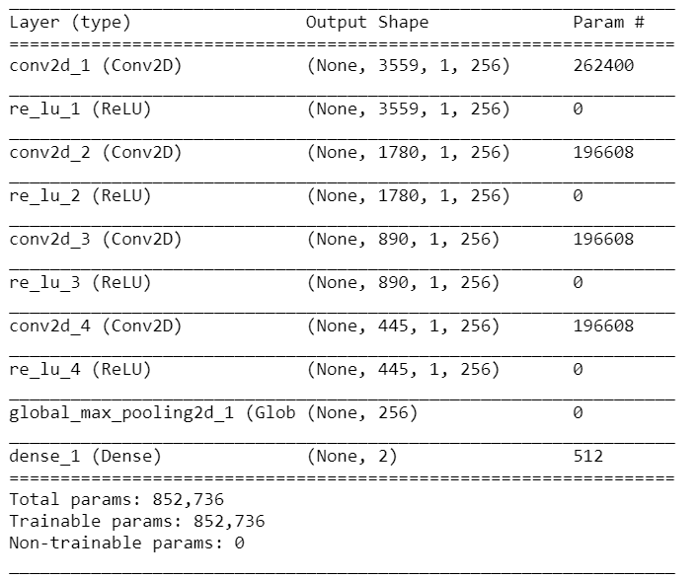
Convolutional Neural Network Model Summary
Notes:
Here is the model summary describing the layers and number of tunable parameters in each step.
______________________________________________________________________________________
Model summary
Zero padded to longest h (number of time steps from longest clip), which was 3559
Note that height is decreasing
Note total number of parameters that are being tuned

Slide 16





How?
Notes:
In order to develop my network, I used AWS S3 storage, Amazon Sagemaker’s Jupyter Notebook’s, and used Keras backed by Tensorflow.

Slide 17
Classification Results
Notes:
In terms of the results,

Slide 18
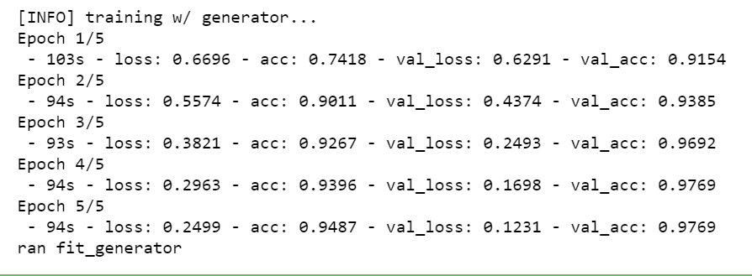
Training: Testing: 2010 data
2010 data
97.69% accuracy
Notes:
When trained and tested on 2010 data, the classifier was 97.69% accurate.
____________________________________________________________________________
Model2_eval&predict.ipynb:
Runs model with .fit_generator, .evaluate_generator, and .predict [NOTE: NOT .predict_generator]
Currently running successfully with 546 training data, 130 validation data, and 170 testing data (ran evaluate and predict on these)
97.6% accuracy on testing data!
NOTE: clean methods for find_max, get_labels_and_samples, and data_generator

Slide 19
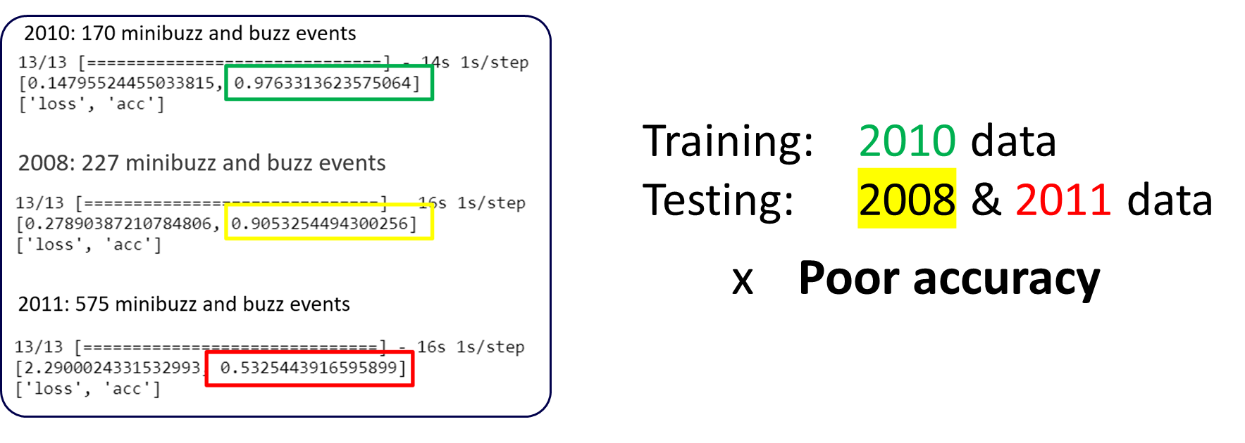
Notes:
However, when I tried it on data from other years, the classifier was 90% accurate for 2008 data and 53% accurate for 2011 data.
______________________________________________________________________________
2008: 227 minibuzz and buzz events (Note: threw out 3 that were too long)
2011: 575 minibuzz and buzz events (Note: threw out 4 that were too long)

Slide 20
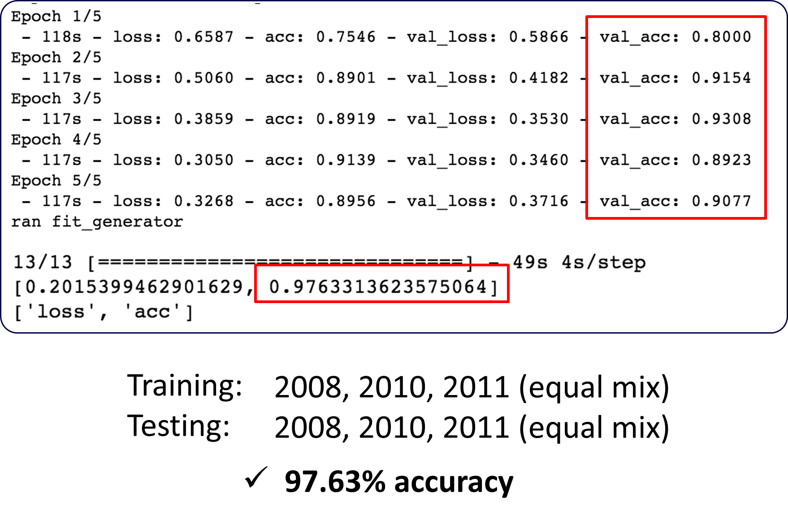
Notes:
Unsatisfied with these poor results, I retrained and tested the model on an equal distribution of buzzes and minibuzzes from all three years, which resulted in a 97.633% accuracy.

Slide 21
Detection in the Time Domain
Notes:
Next I will talk about my attempt for event detection in the time domain.

Slide 22
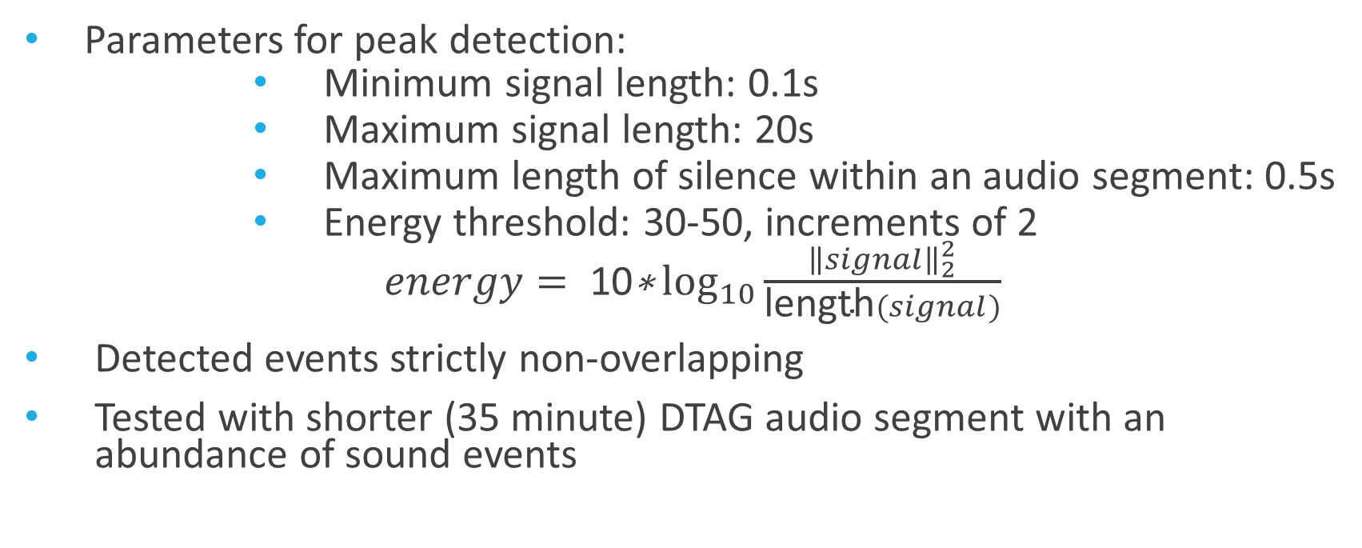
Event Detection: Auditok library
Parameters for peak detection:
Minimum signal length: 0.1s
Maximum signal length: 20s
Maximum length of silence within an audio segment: 0.5s
Energy threshold: 30-50, increments of 2
$energy= \text{10}\text{∗}\log_{10}{\frac{{\left\|signal\right\|}_{2}^{2}}{\text{length}(signal)}}$
Detected events strictly non-overlapping
Tested with shorter (35 minute) DTAG audio segment with an abundance of sound events
Notes:
I used the auditok peak detection library, with tunable parameters such as: minimum signal length, maximum signal length, and maximum length of silence period, and energy threshold defined by this equation. I kept the first three parameters constant and experimented with the energy threshold value. One important thing to note about the auditok library, is that detected events are strictly non-overlapping, which is not necessarily true of DTAG audio events. I tested the detector with a shorter (35 minute) DTAG audio segment with an abundance of sound events, that was shorter than most other audio files.

Slide 23
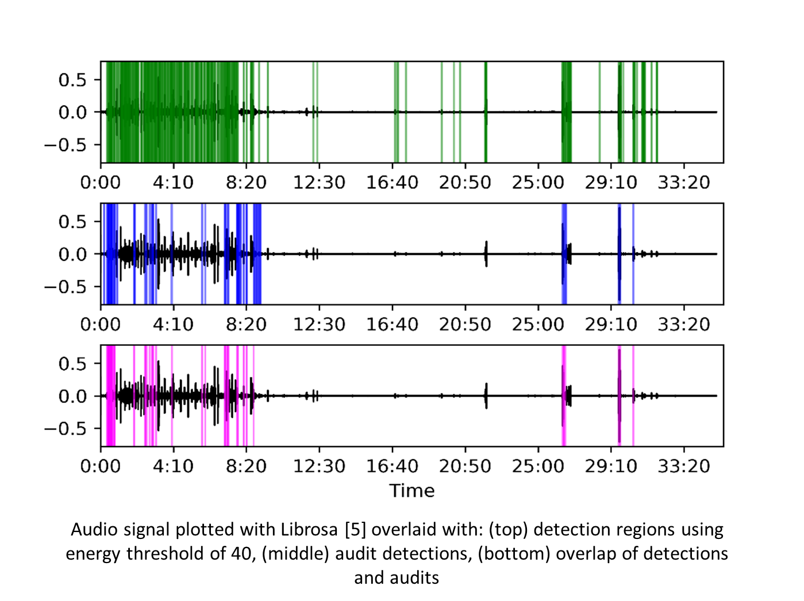
Detection Results
Notes:
Here is a plot showing the auditok detected regions (green), true audit events (blue), and overlap of the two (pink)

Slide 24
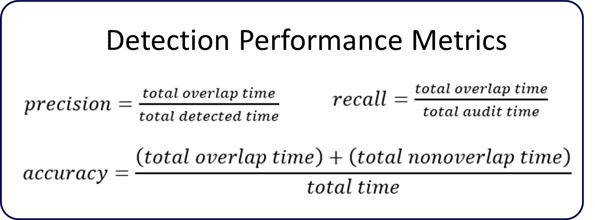
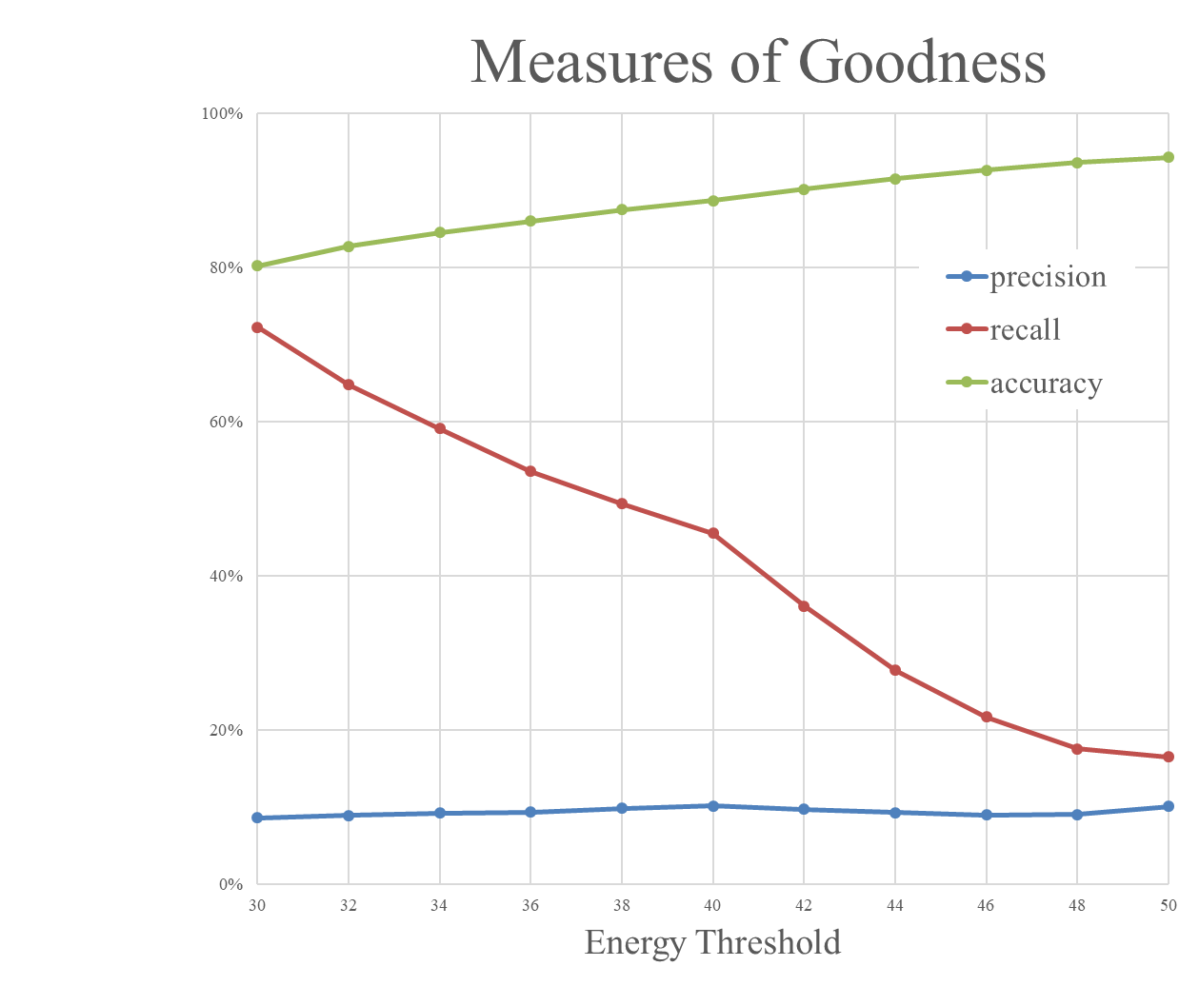
Performance Metrics
Aim to maximize recall (prevent missed events)
Can identify false positives in classification stage
Notes:
Detection performance was evaluated based on precision, recall, and accuracy. As we lowered the energy threshold value, recall increased, which is good because we want to maximize recall in order to not miss any real events. The fact that precision does not change much with lower energy threshold shows that more actual audit sounds were detected by decreasing energy threshold. However, lower accuracy values mean that we are getting more false events as well, which will make the classification network harder to train.
___________________________________________________________________________
Lower energy threshold:
Captured more audit events
Increased recall
Similar precision
Lowered accuracy

Slide 25
Detection Evaluation
Successes
Ignoring silent periods
72% recall rate at e = 30
Clear relationship to parameters, future tuning has the potential to further improve performance
Shortcomings
Acted as a peak detector, but many audit events do not occur at peak sound levels
Detector breaks up continuous sounds (should be processed as single event)
Detector does not allow for overlapping events
Notes:
The detector was successful in ignoring the silent periods and achieved a recall of 72% for low energy threshold values. It demonstrates a clear relationship to the parameters, suggesting further parameter tuning has the potential to improve performance further.
However, the detector fundamentally acted as a peak-detector while many of the audit events do not occur at peak sound levels. In addition, the detector breaks up continuous sound that should be processed together as a single event and does not allow for overlapping events, which are present in the audit file and real life.
Given these many shortcomings, this detection method will not be further pursued in favor of deep learning methods with simultaneous detection and classification.

Slide 26
Future Work
Deep Learning methods for simultaneous detection and classification
Can use classification scheme described here to continuously classify sound chunks using a sliding window(s) of variable size
Current classification scheme already has some duration invariance built in
Retrain the network
Incorporate more training data from new short-finned pilot whales
Train network with distribution of buzzes and minibuzzes proportional to life
Train network on other short-finned pilot whale sounds
Investigate biological trends in data
Acoustic behavior in relation to time of day, depth, and movement

Slide 27
References
[1] NOAA. “Short-Finned Pilot Whale,” Retrieved May 4, 2019, from https://www.fisheries.noaa.gov/species/short-finned-pilot-whale
[2] M. P. Johnson and P. L. Tyack, "A digital acoustic recording tag for measuring the response of wild marine mammals to sound," in IEEE Journal of Oceanic Engineering, vol. 28, no. 1, pp. 3-12, Jan. 2003.
[3] D. Gillespie, M. Caillat, J. Gordon, and P. White, “Automatic detection and classification of odontocete whistles,” The Journal of the Acoustical Society of America, vol. 134, no. 3, pp. 2427–2437, 2013.
[4] T.-H. Lin, H.-Y. Yu, C.-F. Chen, and L.-S. Chou, “Automatic detection and classification of cetacean tonal sounds from a long-term marine observatory,” 2013 IEEE International Underwater Technology Symposium (UT), 2013.
[5] M. Bittle and A. Duncan, “A review of current marine mammal detection and classification algorithms for use in automated passive acoustic monitoring,” Proceedings of Acoustics, vol. 2013, Nov. 2013.
[6] J. Bjorck, B. H. Rappazzo, D. Chen, R. Bernstein, P. H. Wrege, and C. P. Gomes, “Automatic Detection and Compression for Passive Acoustic Monitoring of the African Forest Elephant,” Proceedings of the AAAI Conference on Artificial Intelligence, vol. 33, pp. 476–484, 2019.
[7] K. R. Coffey, R. G. Marx, and J. F. Neumaier, “DeepSqueak: a deep learning-based system for detection and analysis of ultrasonic vocalizations,” Neuropsychopharmacology, vol. 44, no. 5, pp. 859–868, Apr. 2019.
[8] T. Oikarinen, K. Srinivasan, O. Meisner, J. B. Hyman, S. Parmar, R. Desimone, R. Landman, and G. Feng, “Deep Convolutional Network for Animal Sound Classification and Source Attribution using Dual Audio Recordings,” bioRxiv, Jul. 2018.
[9] Z. Zhu, J. H. Engel, and A. Hannun, “Learning multiscale features directly from waveforms,” 2016.
[10] Hertel, Lars & Phan, Huy & Mertins, Alfred, “Classifying Variable-Length Audio Files with All-Convolutional Networks and Masked Global Pooling,” 2016
[11] B. Mcfee, C. Raffel, D. Liang, D. Ellis, M. Mcvicar, E. Battenberg, and O. Nieto, “librosa: Audio and Music Signal Analysis in Python,” Proceedings of the 14th Python in Science Conference, 2015.
[12] https://github.com/amsehili/auditok
Notes:
Here are my references.

Slide 28



Acknowledgements
Dr. Doug Nowacek
Dr. Nicola Quick
Dr. Meagan Dunphy-Daly
Rachel Carson Scholars Program
Notes:
Thank you to Dr. Doug Nowacek, Dr. Nicola Quick, Dr. Meagan Dunphy-Daly, and the Rachel Carson Scholars Program for support and guidance.

Slide 29
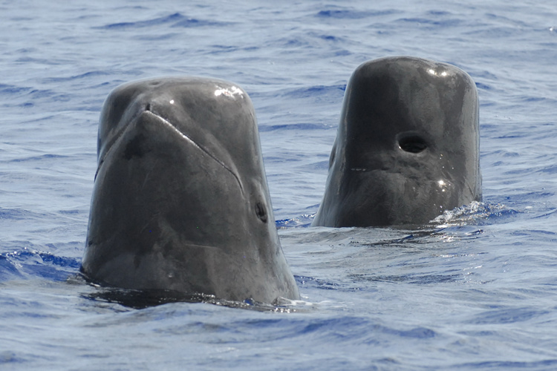
Thank You! Questions?
[3]
Notes:
Thank you, and I’d be happy to answer any questions.

